Slide 1
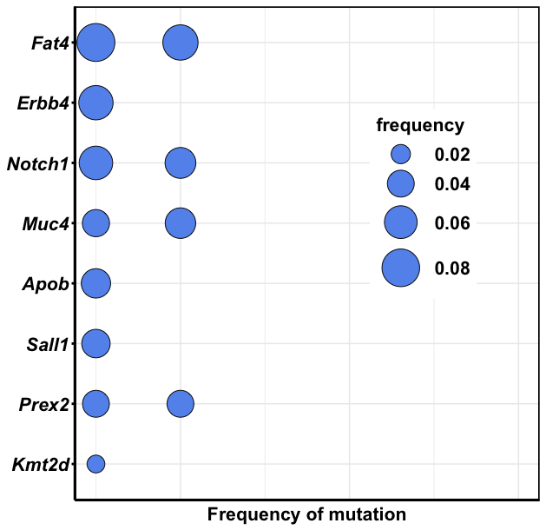
Goliath 445 – 3 mo

Slide 2
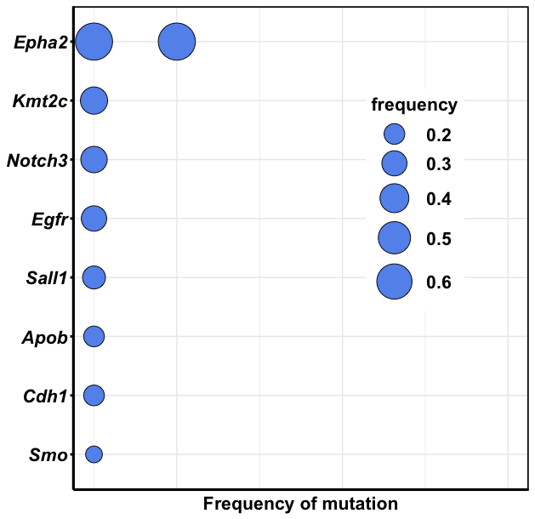
Goliath 9154_1 – 3 mo

Slide 3
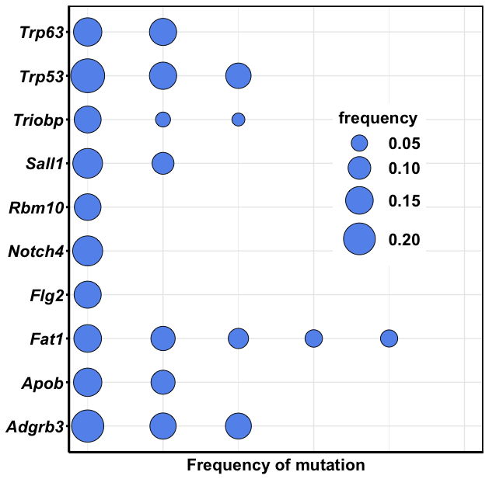
Goliath 9154_2 – 3 mo

Slide 4
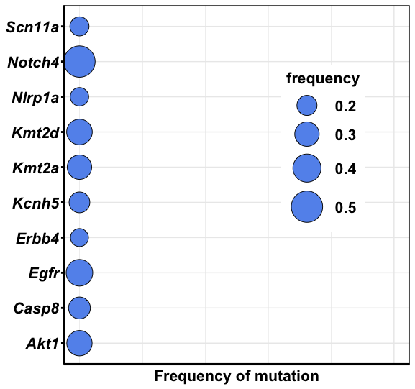
Goliath 9156 – 3 mo

Slide 5
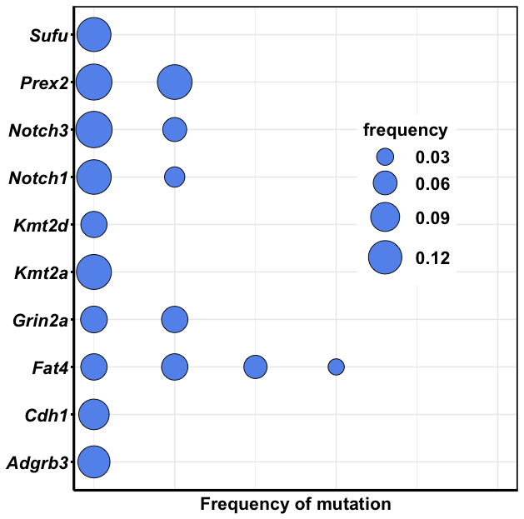
Goliath 9157 – 3 mo

Slide 6
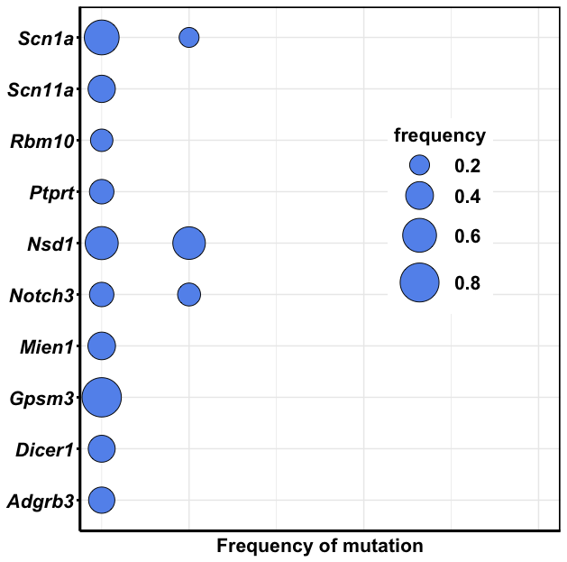
Goliath 9158 – 3 mo

Slide 7
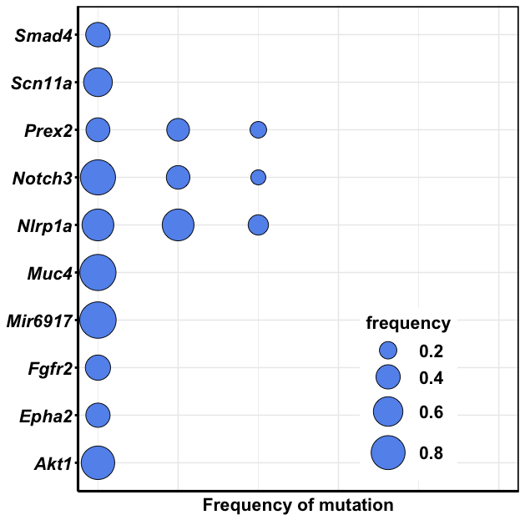
Goliath 9159 – 3 mo

